Slide 1
Unit: IV REDOX TITRATION
By
Dimple Pirgal
Assistant Professor, KLE College of Pharmacy
Bengaluru

Slide 2
Introduction:
▶ Redox Titration is a laboratory method of determining the concentration of a given analyte by causing a redox reaction between the titrant and the analyte. These types of titrations sometimes require the use of a potentiometer or a redox indicator.
▶ Redox titration is based on an oxidation-reduction reaction between the titrant and the analyte.
▶ In order to evaluate redox titrations, the shape of the corresponding titration curve must be obtained. In these types of titration, it proves convenient to monitor the reaction potential instead of monitoring the concentration of a reacting species.

Slide 3
Oxidation & Reduction
Oxidation: A substance can undergo oxidation can occur via:
▶ The addition of oxygen.
▶ Removal of hydrogen which was attached to the species.
▶ The donation/loss of electrons.
▶ An increase in the oxidation state exhibited by the substance.
C + O₂ → CO₂
(Here carbon has gained oxygen and it has been oxidized to carbon dioxide) Fe⁺² – e ⁻ → Fe⁺³
Sn⁺² – 2e⁻ → Sn⁺⁴
▶ In above reactions, there is loss of electrons, hence the concerned ions are said to be oxidized.

Slide 4
Reduction: A substance can undergo reduction can occur via:
▶ The addition of hydrogen.
▶ The removal of oxygen.
▶ The acceptance of electrons.
▶ A reduction in the overall oxidation state.
CUO + H₂ → CU + H₂O
▶ In above reaction, copper oxide has been reduced to copper by loss of oxygen.
CU⁺³ + e⁻ → CU⁺²
(Here gaining of 1 electron, cupric ion is said to be reduced to cuprous ion.)

Slide 5
What are oxidation-reduction reactions?
▶ Oxidation-reduction reactions are chemical reactions that involve the transfer of electrons between the reacting species. These electron transfers are accompanied by a change in the oxidation state of the reactants.
▶ In a chemical reaction, oxidation and reduction occur simultaneously. If one atom is oxidized, other is reduced.
Fe⁺² + Cl₂ → 2Fe⁺² + 2Cl⁻ [2(FeCl)]
▶ In the above reaction, Ferrous ion is oxidized to Ferric ion by loss of 1 electron and Chlorine has been reduced to chloride ion by gain of 1 electron. Therefore, these reactions are called as redox reactions.

Slide 6
Oxidizing & Reducing Agents
What are oxidizing agents?
▶ These are the agents which themselves get reduced i.e. they accept electrons and oxidize other elements. They are also called oxidizer or oxidants.
▶ Examples: potassium dichromate, potassium permanganate, ceric sulphate, iodine, nitric acid (HNO3) and hydrogen peroxide (H2O2) etc.
What are reducing agents?
▶ These are the agents which themselves get oxidized i.e. they donate electrons and reduce other elements. They are also called as reductants or antioxidants.
▶ Examples: oxalic acid, ferrous sulphate, titanious sulphate, sodium thiosulphate, zinc and lithium, etc.

Slide 7
KMnO₄ + FeSO₄ + H₂SO₄ → MnSO₄ + Fe₂ (SO₄)3 + K₂SO₄ +H₂O
(Here, electrons are transferred from FeSO₄ to KMnO₄)
▶ Mn (+7) in KMnO₄ has been reduced to Mn (+2) in MnSO4.
▶ Fe(+2) in FeSO₄ has been oxidized to Fe (+3) in Fe2(SO₄)3.
▶ Thus, KMnO₄ acts as oxidizing agent and FeSO4 acts as reducing agent in acidic medium.
Half Reaction:
▶ In redox titrations, two reactions take place simultaneously, oxidation and reduction. Oxidation and reduction reactions, each are known as half reactions.
Consider the following reaction:
Ce⁺⁴ + Fe⁺²
▶ Oxidation half reaction may be written as:
_{Fe}+2
▶ Reduction half reaction may be written as:
Ce⁺³ + Fe⁺³
Fe⁺³ + e ⁻
Ce⁺⁴ + e⁻
_{Ce}+3

Slide 8
Detection of End Point In Redox Titrations:
Following indicators can be used in redox titrations to determine the end point.
Internal or redox indicators
Self indicators
External indicators
Specific indicators
Potentiometric methods

Slide 9
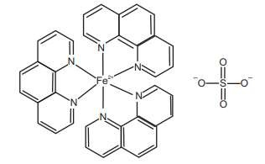

1. Internal or redox indicators : These are the redox indicators (also called an oxidation-reduction
indicators) which undergo oxidation-reduction reaction at the equivalence point.
▶ The indicator has different colour in oxidized and reduced form. Thus, end point is marked by a
colour change. There are two common types of redox indicators:
Metal-organic complexes (Eg. phenanthroline)
True organic redox systems (Eg. Methylene blue)
e.g. Diphenylamine Ferroin
2. Self indicators: A coloured substance may act as its own indicator.
▶ For example: potassium permanganate, ceric ammonium sulphate, iodine.
▶ KMnO4 gets reduced in redox titration as follows:
MnO₄⁻ + 4H⁺ Mn² ⁺ + 4H₂O

Slide 10
External indicators: These are also called as spot test indicators. These were used earlier when no indicators were available.
▶ For example: Ferricyanide ion was used to detect iron (II) ion by formation of iron
(II) ferricyanide (Turnbull’s blue) on a spot plate outside titration vessel.
Specific Indicators: It is as a substance which reacts in a specific manner with one of the reagents in a titration to produce colour.
▶ For example: Starch gives deep blue colour with iodine (1% solution of starch is used); Thiocyanate gives red colour with iron (III).
Potentiometric Method: It is a physicochemical method where the equivalence point is detected by large changes in potential. This method can be used when suitable indicators are not available, visual method is of limited accuracy (coloured solutions or very dilute solutions). Potential is measured by a potentiometer. At end point, there is sudden rise in potential.

Slide 11
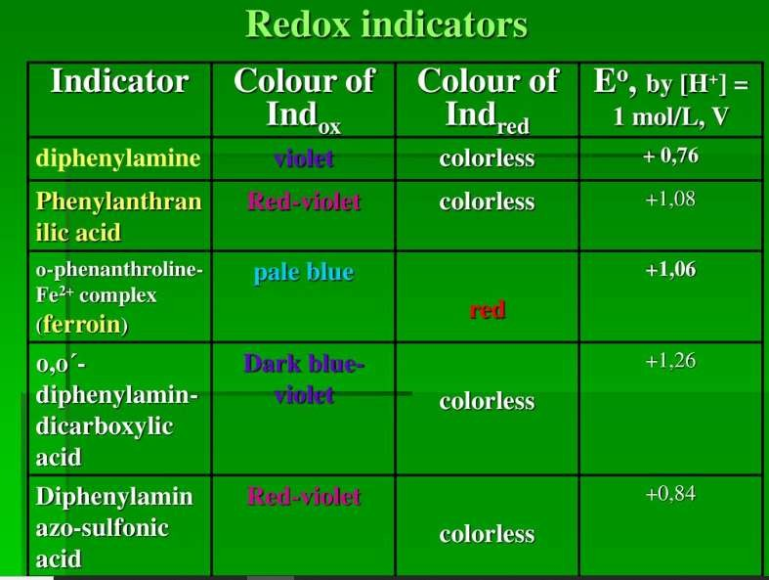

Slide 12
TYPES OF REDOX TITRATIONS
Redox titration | Titrant
Iodometry | Iodine (I₂)
Bromatometry | Bromine (Br₂)
Cerimetry | Cerium(IV) salts
Permanganometry | Potassium permanganate
Dichrometry | Potassium dichromate

Slide 13
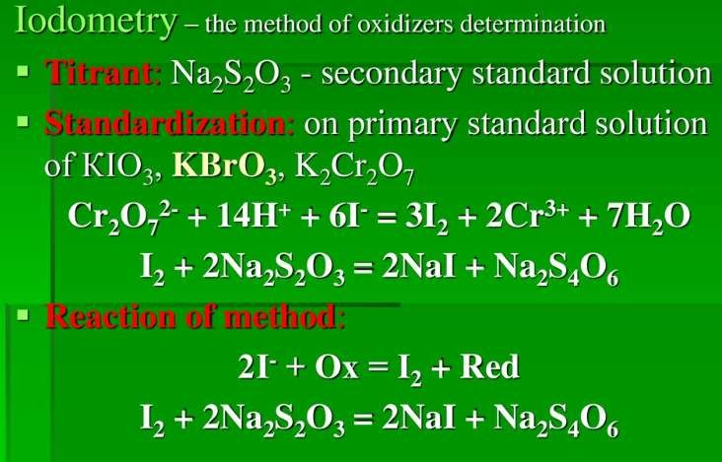
1. Iodometry & Iodimetry (Iodine Titration)
Iodometry: The oxidizing agent oxidizes iodide to iodine. Iodine dissolves in the iodide-containing solution to give triiodide ions, which have a dark brown color. The triiodide ion solution is then titrated against standard thiosulfate solution to give iodide using starch indicator till blue colour changes to colourless.
2I– + 2e → I₂
I₂ + I– → I₃ –
Na₂S₂O₃ + I₃ – → NaI + Na₂S₄O₆
Preparation of 0.1 M Sodium Thiosulphate Solution: Dissolve 25 g of sodium thiosulphate and 0.2 g of sodium carbonate in carbon dioxide free water and dilute to 1 litre with water.
Standardization of Sodium Thiosulphate: Dissolve accurately weighed 0.200 gm of potassium bromate in water to produce 250 ml to 50 ml of this solution. Add 2 gm of potassium iodide and 3 ml of 2M hydrochloric acid and titrate with sodium thiosulphate solution using starch indicator until blue colour disappears.
Factor: Each ml of 0.1 M sodium thiosulphate is equivalent to 0.002784 gm of KBrO3

Slide 14
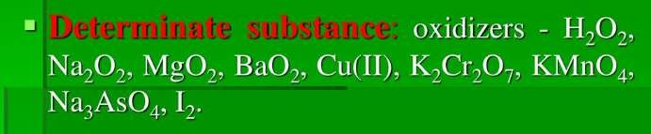
Conditions for Iodometric Titrations:
Titration must be carried out in acidic conditions.
In highly alkaline conditions, NaOI (Sodium hypo-iodide) is formed which is a strong oxidizing agent as compared to iodine.
2NaOH + I₂ → NaOI + NaI + H₂O
Reaction mixture must be kept in dark to decrease volatilization of iodine.
Titration must be carried out in closed flask and in cold conditions to prevent volatilization of iodine.

Slide 15
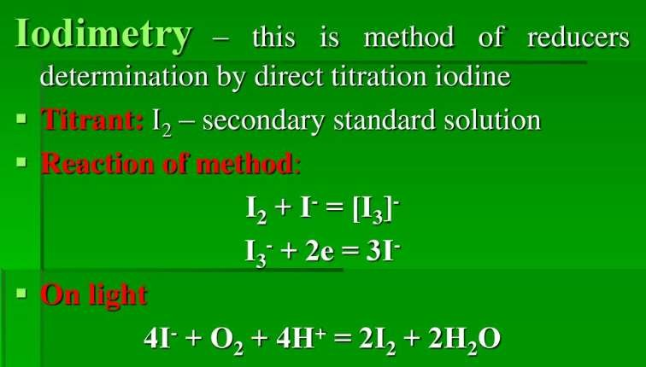
Iodimetry: In iodimetry, standard solution of iodine is used as a titrant. It is based on following reaction:
2I ⁻ I₂ + 2 e⁻
It is used for estimation of reducing agents like arsenates (H₃AsO₃) and thiosulphates (Na₂S₂O₃).
I. Preparation of Iodine Solution: Dissolve 14 gm of iodine in solution of 36 gm of potassium iodide in 100 ml of water, add 3 drops of hydrochloric acid and dilute with water to 1000 ml. Iodine is slightly soluble in water (0.00134 mol/lit). Therefore, potassium iodide is added to increase the solubility and to decrease the volatility of iodine.
I₂ + I ⁻ → I

Slide 16
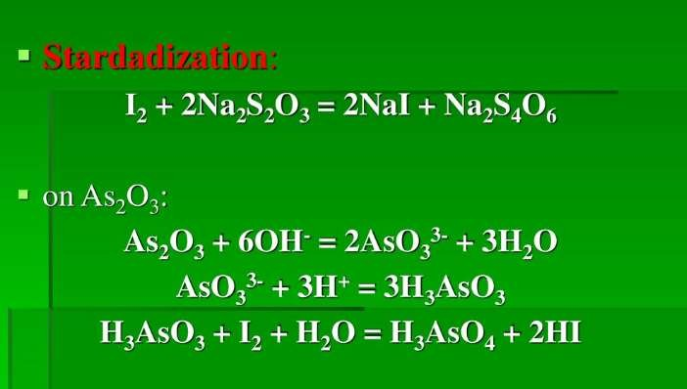
Conditions for Iodimetric Titrations:
II. a. Standardization of Iodine Solution with Arsenic Trioxide: Weigh 0.15 gm of arsenic trioxide previously dried at 105°C for 1 hour and dissolve in 20 ml of 1 M sodium hydroxide solution by warming if necessary. Dilute with 40 ml of water, add 2 drops of methyl orange solution and add dilute HCl solution until the yellow colour changes to pink. Then add 2 gm of sodium bicarbonate, dilute with 50 ml of water and add 3 ml of starch mucilage as indicator. Slowly titrate with iodine solution until permanent blue colour is obtained.
As iodine is volatile, titration must be
conducted in cold conditions.
As solubility of iodine is low in water,
excess of KI must be used to dissolve it.
Sufficient time should be given before
titration, as iodine ionizes too slowly.
The reaction mixture should be kept in
dark, as
light accelerates the side
Iodide ions are oxidized to
reactions.
iodine by atmospheric oxygen.
4I⁻ + 4H+ O₂ → 2I₂+ 2H₂O

Slide 17
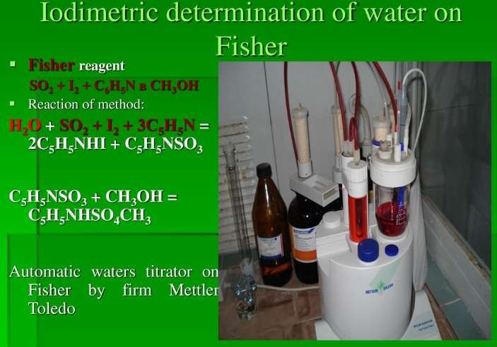

Slide 18
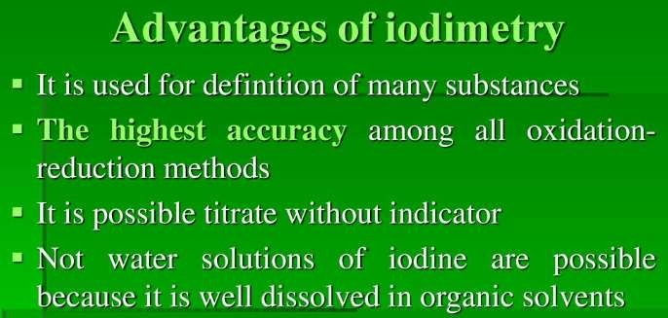

Slide 19
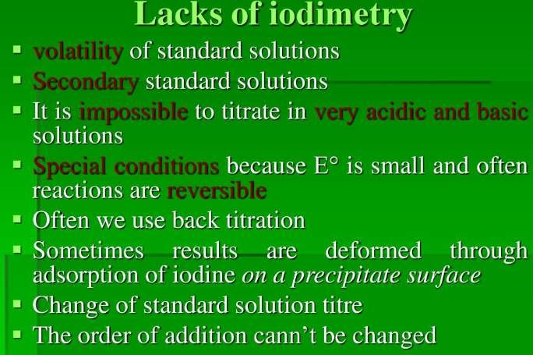

Slide 20
2. Bromatometry
When potassium bromates (KBrO3) is used as titrant, the titration is known as
Bromatometry.
Potassium bromate is a strong oxidizing agent and is used for assay of number of
pharmaceutical substances like, mephensin, phenol, sodium salicylate, etc.
Reagent can be employed in 2 ways:
Direct titration
Bromination
1. Direct titration: Reducing substances like As (III), Sb (II), Fe (II) and certain organic sulphides and disulphides can be titrated directly with potassium bromate.
BrO₃⁻ + HAsO₂ → Br ⁻ + HAsO₃ BrO₃⁻ + Br⁻ + H+ → Br₂ + H₂O
Appearance of bromine is sometimes suitable for detection of end point. Organic indicators like alpha-naphthoflavone, quinoline yellow and p-ethoxychrysoidine can also be used.

Slide 21
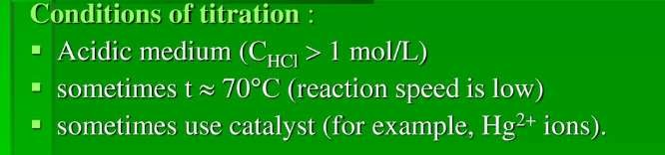
2. Bromination of Organic Compounds: Potassium bromate-potassium bromide (KBr-KBrO₃) mixture is used for liberation of bromine.
KBrO₃ + 5KBr + 3H₂SO₄ → 3K₂SO₄ + 3Br₂ + 3H₂O
Bromine is then used for bromination of organic compounds. Excess of Bromine is then determined by addition of KI.
Br₂ + KI → I₂ + Br-
I2 + S₂O₃ ²⁻ → I− + S₄O₆²⁻
Preparation of 0.1 N Potassium Bromate: Weigh accurately about 2.784 gm of potassium bromate and 12 gm of potassium bromide in water and dilute to 1000 ml with water.
Standardization of Potassium Bromate: Transfer 30 ml of 0.1 N potassium bromate solution in 250 ml iodine flask. Add 3 gm potassium iodide and 3 ml of hydrochloric acid. Mix the contents thoroughly and allow to stand for 5 minutes. Titrate the liberated iodine with previously standardized 0.1 N sodium thiosulphate using 3 ml of freshly prepared starch solution as indicator added towards the end.
Factor: Each ml of 0.1 N sodium thiosulphate is equivalent to 0.002784 gm of KBrO₃.

Slide 22
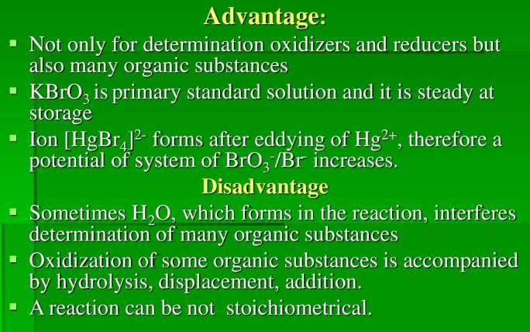

Slide 23
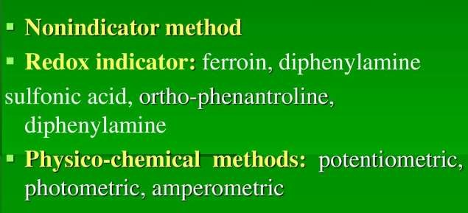
3. Cerimetry
Titrations involving determinations with cerium compounds are called Cerimetry.
Atomic weight of Cerium is 140 gm/mol.
It exists in 2 oxidation states: +4 and +3.
In tetravalent (Quadrivalent) state it acts as a powerful oxidizing agent.
It is of dark yellow colour in concentrated solution.
On reduction trivalent cerium ion is obtained, which is colourless.
Some of the compounds of Cerium such as Ceric ammonium nitrate (NH₄)2Ce(NO₃)6, Ceric ammonium sulphate (NH₄)4Ce(SO₄)4, Ceric hydroxide Ce(OH)4 can be used for determination.
Indicators:

Slide 24
Preparation of 0.1 M Ceric Ammonium Nitrate Solution: Dissolve 65 gm of ceric ammonium sulphate with help of gentle heat, in a mixture of 30 ml sulphuric acid and 500 ml water. Cool it. Filter if turbid and dilute with water to 1000 ml.
Standardization of 0.1 M Ceric Ammonium Nitrate Solution: Weigh accurately about
0.2 gm of arsenic trioxide, previously dried at 105°C for 1 hour and transfer to 500 ml conical flask. Wash with 25 ml of 8% w/v solution of sodium hyrdroxide, swirl to dissolve, add 100 ml of water and mix. Add 30 ml of dilute sulphuric acid, 0.15 ml of osmic acid solution, 0.1 ml of ferroin solution and titrate with ceric ammonium nitrate, until pink colour is changed to very pale blue.
Factor: Each ml of 0.1 M ceric ammonium nitrate is equivalent to 0.004946 gm of As₂O₃.

Slide 25
Advantages of Cerimetry over Pemanganometry:
Cerium can be reduced to only one oxidation state.
It is very strong oxidizing agent and its intensity can be varied using different acids.
Sulfuric acid solutions are extremely stable.
No effect of light or heating for short time.
Cerium nitrate is available in sufficiently pure form to directly prepare standard solution.
Applications of Cerimetry:
Titration of hydrogen peroxide.
Ferrous compounds can be analyzed.
Oxalates can be analyzed using ceric sulphate.
Analysis of tartaric acid, phthalic acid, saliculic acid.
Nitrogen compounds like hydroxylamines, nitrites can also be analyzed.

Slide 26
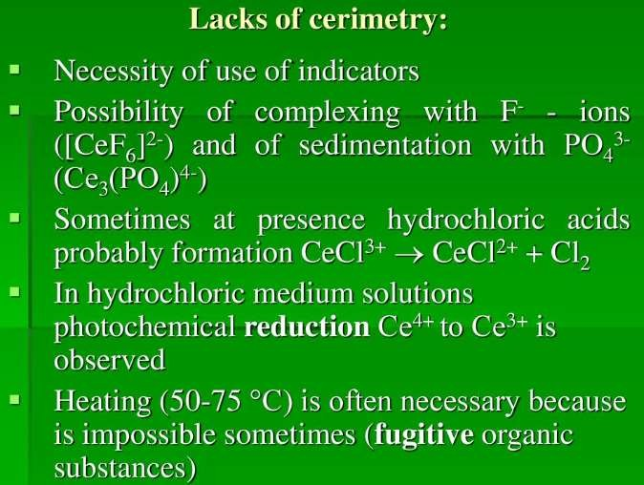

Slide 27
4.Permagnometry
Potassium permanganate is widely used as oxidizing agent in redox titrations.
It is readily available and inexpensive. It requires no indicators except in very dilute
solutions.
Permanganate undergoes a variety of chemical reactions, since manganese can exist in
oxidation states of +2, +3, +4, +6, +7.
It reacts rapidly with reducing agents as follows:
MnO₄⁻ + 8H ⁺ + 5e ⁻ = Mn ⁺² + 4H₂O
Preparation of 1 M KMnO4: Dissolve 158 gm of KMnO4 in water to make up volume to
1000 ml. Heat on water bath for 1 hour, allow standing for 2 days. Filter through glass wool.
a) Standardization of KMnO4: Primary standards like Arsenious oxide, Sodium oxalate/Oxalic acid, Sodium thiosulphate, Iron can be used for standardization of potassium permanganate.

Slide 28
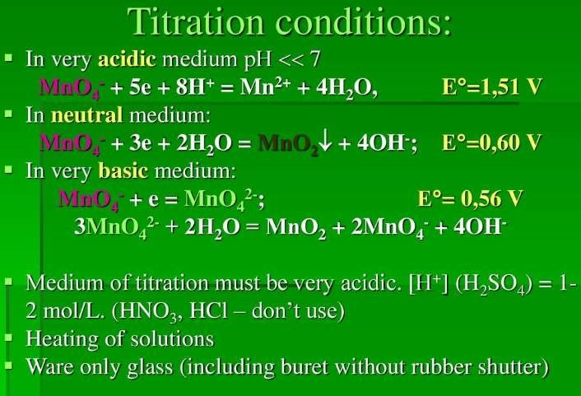
II. b) Standardization with Sodium Oxalate: Dissolve 6.7 gm of sodium oxalate previously dried at 110°C in water and then make up volume to 1 litre. Pipette out 20 ml of this solution to conical flask, add 5 ml of concentrated sulphuric acid and then warm to 70°C. Titrate against KMnO4 until pink colour persists for 30 s.
5Na₂C₂O₄ + 2KMnO₄+ 8H₂SO₄ K₂SO4 + 2MnSO₄+ 10CO₂ + 5Na₂SO₄ + 8H₂O

Slide 29
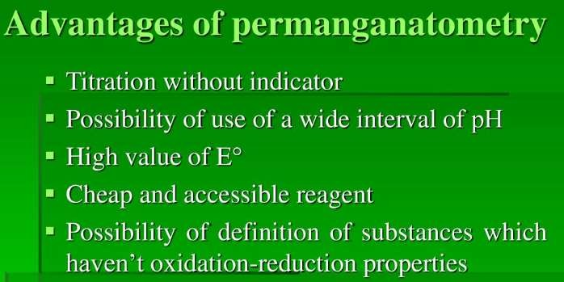
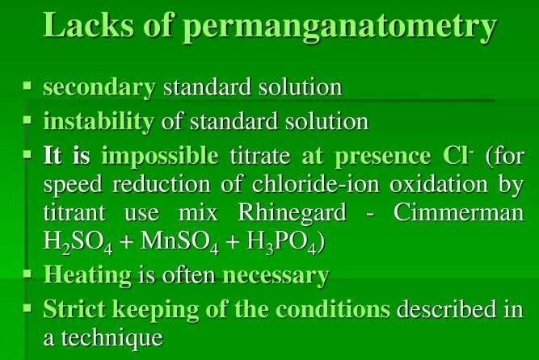

Slide 30
5.Dichrometry
Titration involving potassium dichromate (K₂Cr₂O₇) as titrant is known as dichrometry. Dichromate titrations are based on conversion of dichromate ion containing hexavalent chromium into trivalent chromium ions.
Cr₂O²⁻ + 14 H⁺+ 6e → 2Cr⁺³+ 7H O
7 2
Indicators:
External indicators: Potassium ferricyanide.
Internal indicators: Diphenylamine, Diphenylamine sulfonate.
Colour change: green to violet
Diphenylbenzidine,

Slide 31
Preparation of 0.1 N K2Cr2O7: Dissolve 4.9036 gm equivalent of K₂Cr₂O₇ previously powdered and dried in a dessicator for 4 hours, and dissolve in water to produce 1000 ml. Potassium dichromate can be obtained as a primary standard reagent and standard solution may be prepared determinately and stored for long periods of time.
Standardization of Potassium Dichromate: To 20 ml of solution, add 1 gm of
potassium iodide and 7 ml of 2 M hydrochloric acid. Add 250 ml water and titrate against
0.1 m sodium thiosulphate using 3 ml starch solution until the colour changes from blue to
light green.
Factor: Each ml of sodium thiosulphate is equivalent to 0.0049 gm of K₂Cr₂O₇.

Slide 32
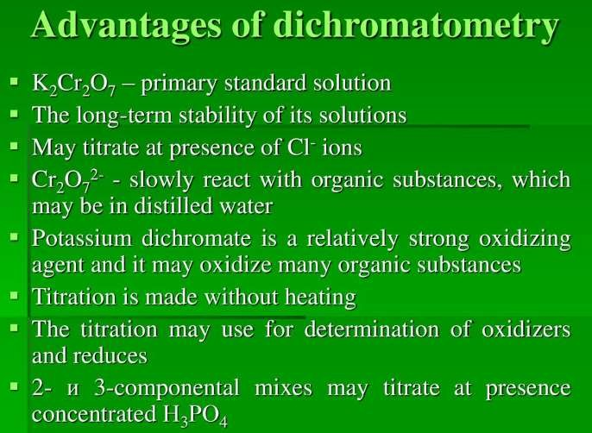

Slide 33
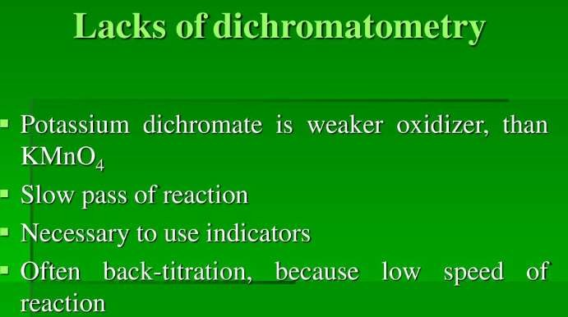

Slide 34
Question Bank
Short Answer Questions: Long Answer Questions:
1. What are redox titrations?
1. Explain the concepts of
agent and reducing agent in
oxidizing
Enlist the various titrants used in redox
titrations.
Name redox indicators.
What is iodimetry?
What is equivalent weight?
Explain equivalent weights concept.
Explain the Nernst equation.
What are conditions for iodometric titrations.
Give difference between iodometry and
iodimetry.
How will you prepare and standardize 0.1 N
sodium thiosulphate.
How will you prepare and standardize 0.1 M
ceric ammonium nitrate.
How will you prepare and standardize 0.1 N
Iodine solution.
Explain the titrations with potassium iodate.
redox
titrations.
2. Explain the methods to balance redox
reactions.
3. Explain the methods of end point
detection in redox titrations.
Write a note on permanganometry.
Write a note ion cerimetry.
Give an account of dichrometry.
Write a note on bromatometry.
8. Write a note on preparations of
potassium permanganate. What
precautions are to be kept while
preparing it.

Slide 35
Thank You…

