Slide 1
Higuchi and Peppas plot

Slide 2
“Drug release” refers to the process in which drug solutes migrate from the initial position in the polymeric system to the polymer’s outer surface and then to the release medium.
This process is affected by complex factors such as the
physicochemical properties of the solutes,
the structural characteristics of the material system,
release environment, and
the possible interactions between these factors

Slide 3
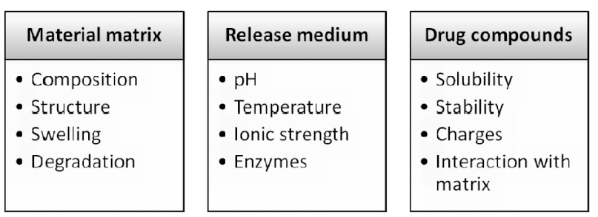
Solute diffusion, polymeric matrix swelling, and material degradation are the main driving forces for solute transport from drug containing polymeric matrices.

Slide 4
Non-degradable polymeric matrices
Non-degradable polymers
polyurethanes, silicone,
rubber,
poly (ethylene vinyl acetate)
Non-degradable polymers can be fabricated into “reservoir-” and “matrix-” type devices.
Solute transport from non-degradable polymeric systems is mainly considered as diffusion driven.
Reservoir type: The release rate remains relatively constant and is not affected by concentration gradient, but most likely is related to the thickness and permeability of polymeric membrane.
Matrix type: drug release is more likely to be Fickian diffusion driven, which is associated with concentration gradient, diffusion distance, and the degree of swelling

Slide 5
Biodegradable polymeric matrices
Biodegradable polymers contain labile bonds such as ester-, amide-, and anhydride-bonds that are prone to hydrolysis or enzymatic degradation.
Types of degradation are
Surface degradation and
Bulk degradations are two typical modes of degradation.
In a surface degrading polymer, degradation is confined to the outer surface of the device.
In a bulk degrading polymer, degradation occurs homogeneously through out the material.
Water is an important factor during hydrolysis and thus water intrusion into the device is of significant importance for the study of degradation kinetics as well as release kinetics.

Slide 6
Diffusion
Diffusion is defined as the process of mass transfer of individual molecules of a substance from one part of a system to another, carried by random molecular motion, and is associated to forces such as concentration gradient.
Diffusion process is explained by Fick’s law of diffusion
Fick's first law of diffusion states that the rate of transfer of molecules from regions of high concentration to regions of low concentration is proportional to the concentration gradient.

Slide 7
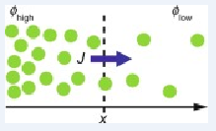

In a one-dimensional model of diffusion, the law is expressed as:
Where J is the flux: number of molecules per unit area per unit time (e.g., mol m⁻ ² s⁻ ¹)
D is the diffusion coefficient: length² time⁻ ¹ (e.g., m²/s)
φ is the concentration: number of molecules per unit volume (e.g., mol m⁻ ³)
The flux J is positive when the gradient ∂φ/∂x is negative, because diffusion occurs to level the gradient.

Slide 8


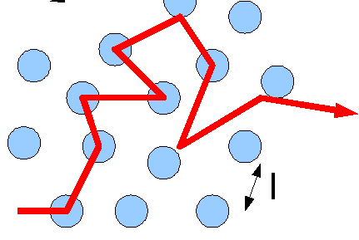
Fick’s Second Law of Diffusion
Where dc/dt represents the rate of change of concentration in a certain area
accounts for a varying concentration in the system.
Diffusion can be thought of as a series of random steps that the particle takes as it moves from where it started.
These steps can either lead the particle away from where it started, or lead back to where it started.

Slide 9
Fick’s law of diffusion provides the fundamental for the description of solute transport from polymeric matrices.
Two types of diffusion are
Fickian diffusion (the polymer relaxation time (t_{r}) is much greater than the characteristic solvent diffusion time (t_{d})
Non-Fickian or anomalous diffusion (tr ≈ td)

Slide 10
Mathematical models for drug release kinetics from polymeric systems
Empirical models
Diffusion controlled models
Degradation based models
Erosion based model
Mathematical models for multi-component system.

Slide 11
Empirical model
These models are easy to use and the established empirical rules may help explain transport mechanism(s).
But these models do not provide additional insights into a more complex transport mechanism.

Slide 12
Model dependent methods
Zero-order model
First order model
Higuchi model
Korsmeyer-Peppas model
HixsonñCrowell model

Slide 13
Zero-order model
Drug dissolution from dosage forms that do not disaggregate and release the drug slowly can be represented by the equation:
dc/dt = -K
C_{t} = C₀ + K₀t
where
C_{t} is the amount of drug dissolved in time t,
C₀ is the initial amount of drug in the solution
K₀ is the zero order release constant expressed in units of concentration/time.

Slide 14
To study the release kinetics, data obtained from in vitro drug release studies were plotted as cumulative amount of drug released versus time
Application of Zero order kinetics
This relationship can be used to describe the drug dissolution of several types of modified release pharmaceutical dosage forms (transdermal systems, matrix tablets with low soluble drugs in coated forms, osmotic systems, etc….)

Slide 15


First order model
The release of the drug which followed first order kinetics can be expressed by the equation
where
C₀ is the initial concentration of drug,
k is thefirst order rate constant, and
t is the time

Slide 16
The data obtained are plotted as log cumulative percentage of drug remaining vs. time which would yield a straight line with a slope of K/2.303.
Application:
This relationship can be used to describe the drug dissolution in pharmaceutical dosage forms such as those containing water-soluble
drugs in porous matrices

Slide 17
Higuchi kinetics
Higuchi model: This is the first mathematical model that describes drug release from a matrix system, proposed by Higuchi in 1961.
The release of a drug from polymeric micro-particles or matrices when placed in contact with a fluid is basically a mass transfer of drug molecules.
Drug moves from a region of high concentration (dosage form) to a region of low concentration (surrounding fluid).
Higuchi kinetics addresses the rate of release of a drug, from a polymeric matrix, (where the loading of solute, A, exceeds its solubility, Cs, in the matrix,) into a surrounding fluid.

Slide 18
Two geometric systems
unidirectional leaching or extraction from a simple planar surface
three dimensional leaching or extraction from a spherical pellet (ex: tablet)

Slide 19
Two mechanisms of release
(a) Extraction of the medicament by a simple process through and from an enveloping, homogeneous matrix.
The drug is presumed to go successively from the crystal surfaces into the uniform matrix and out into the bathing solvent which in turn acts as a perfect sink.
(b) Leaching of the medicament by the bathing fluid which is able to enter the drug-matrix phase through pores, cracks, and intergranular spaces. The drug is presumed to dissolve slowly into the permeating fluid phase and to diffuse from the system along the cracks and capillary channels filled with the extracting solvent.

Slide 20
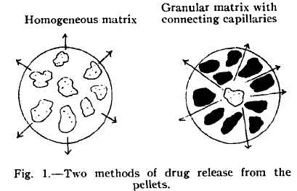

Slide 21
Release from a planar System Having a Homogeneous Matrix.
Release from a Planar System Having a Granular Matrix.
Release from a Spherical Pellet Having a Homogeneous
Matrix.
Release by Leaching from Granular Spherical
Pellet.

Slide 22

Release from a planar System Having a Homogeneous Matrix
The amount of total drug released from such a system into a bathing medium acting essentially as a perfect sink would be determined by the relationship
Q = the amount of drug released after time t per unit exposed area
D = the diffusitivity of the drug in the homogeneous matrix media,
A = the total amount of drug present in the matrix per unit volume, and
Cs =the solubility of the drug in the matrix substance
(Applicable to ointment base containing finely dispersed drugs & Equally applicable for release from a sustained-action matrix)

Slide 23

Release from a Planar System Having a Granular Matrix
The leaching type release mechanism occurring through diffusion movement utilizing inter granular openings
Q = the amount of drug released after time t per unit exposed area,
D = the diffusitivity of the drug in the permeating fluid,
τ = the tortuosity factor of the capillary system
A = the total amount of drug present in the matrix per unit volume,
C = the solubility of the drug in the permeating fluid,
and ε = the porosity of the matrix.

Slide 24
For both equations the derivation is based on the existence of a pseudo steady state condition during the release process
and on the assumption that
the drug particles are quite small relative to the average distance of diffusion and are uniformly distributed in the matrix.
the systems are neither surface coated, nor that their matrices undergo significant alteration in the presence of moisture.
Initial drug concentration in the matrix is much higher than drug solubility,
Drug diffusion takes place only in one dimension
Swelling of matrix and dissolution are less or negligible,
Drug diffusivity is constant,
Perfect sink condition are always attained in the release environment.

Slide 25
The equations would be essentially valid for systems in which A is greater than Cs or εCs by a factor of three or four.
If A <Cs or εCs the drug would no longer be present as a solid and a different equation would apply.

Slide 26
Release from a Spherical Pellet Having a Homogeneous Matrix.
Release by Leaching from Granular Spherical Pellet.

Slide 27
In real systems, however, a number of other factors may come into play which may modify the total behavior
Other serious deviations are
For example, for pellets containing a relatively high percentage of drugs the leaching process would tend to weaken the matrix structure and produce erosion. This may play a significant role in altering the observed real rate.
Another effect which is not considered in these treatments is the influence of solvent flow induced within the pellets by external agitation. This effect, however, will be important only with pellets of relatively high porosity.

Slide 28
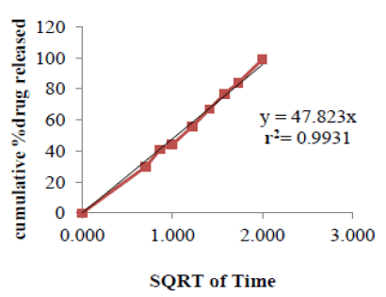
Higuchi equation can be represented in the simplified form where, K_{H} is the Higuchi dissolution constant.
The data obtained were plotted as cumulative percentage drug release versus square root of time.
Higuchi model will result a linear Q versus t^{1/2} plot having gradient, or slope, equal to K_{H}
Based on R value
Higuchi equation suggests that the drug release takes place by diffusion

Slide 29
Korsemeyer- peppas model:
Korsemeyer et al. (1983) derived a simple relationship which described drug release from a polymeric system
The simple exponential relation Mt/M∞ = kt^{n} describes the general solute release behavior of controlled release polymeric devices (non – swellable polymer)
Where Mt/M∞ is the fractional solute release
t is the release time,
k is a constant, and
n is the diffusional exponent characteristic of the release mechanism.
This equation can adequately describe the release of drugs or other solutes from slabs, spheres, cylinders and discs (tablets), regardless of the release mechanism.

Slide 30

To find out the mechanism of drug release, first 60% drug release data were fitted in Korsmeyern Peppas model
In theory, this equation should only be applicable to the first 60% of fractional release from thin slabs, for which the assumption of one-dimensional diffusion under perfect sink conditions is valid.

Slide 31
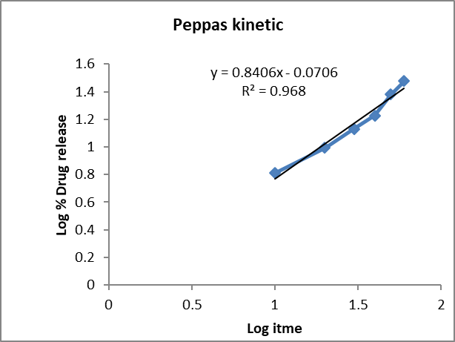
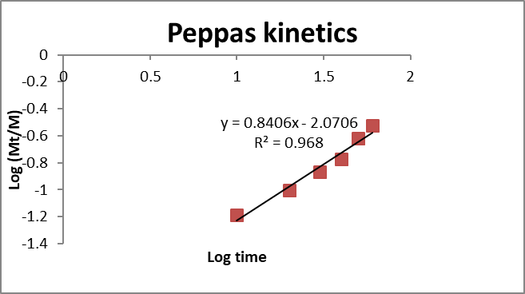
A graphical representation for any geometry, plotted as normalized release, M_{t}/M∞ versus dimensionless time, ‘t’ gives important information about the diffusional release mechanism of a drug from a swellable polymeric device.
[A plot between log of Mt/Mα against log of time will be linear if the release obeys Korsmeyer-Peppas equation and the slope of this plot represents “n” value.]

Slide 32
The ‘n’ value is used to characterize different release
It is shown that in cases of pure Fickian release the exponent ‘n’ has the limiting values of 0.50, 0.45, and 0.43 for release from slabs, cylinders and spheres, respectively.
For tablets, and depending on the aspect ratio, i.e., the ratio of diameter to thickness, the Fickian diffusion mechanism is described by 0.43 < n < 0.50.
For drug release from spherical polymer particles of a wide distribution, the value of the exponent ‘n’ for Fickian diffusion depends on the width of the distribution.

Slide 33
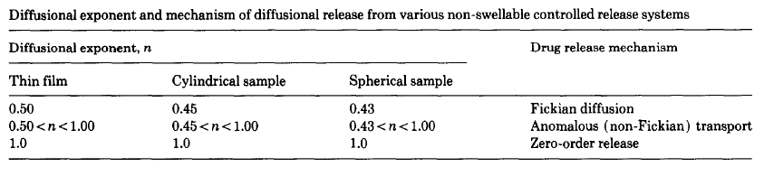

Slide 34
Fickian and non-Fickian release behavior of swelling-controlled release systems
In swelling-controlled release systems the dissolution medium (penetrant ) surrounding the controlled release device may enter the polymer at a rate that controls the drug release.
The molecular mechanism is a
coupling of diffusion and macromolecular relaxation
This results in diffusion of drug outward with a kinetic behavior that is dependent on the relative ratio of diffusion and relaxation

Slide 35
Different models of swellable polymers
Models to describe drug release from a plane sheet
Release behavior in cylinders and
Release behavior in spheres
Mathematical model for release from polydisperse systems

Slide 36
Case-I (Fickian diffusion) and Case-II solute release behavior in swelling-controlled release systems are unique in that each can be described in terms of a single parameter.
Case- I transport is described by a diffusion coefficient,
Case-II transport is described by a characteristic relaxation constant.
Non-Fickian behavior (anomalous transport),
by comparison, requires two or more parameters to describe the coupling of diffusion and relaxation phenomena.

Slide 37
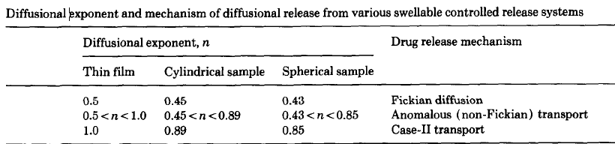
If n=1 it is zero order kinetics case-II transport mechanism in which drug is released constantly by polymer relaxation. If n>1 then it is called Super case-II transport , where drug is released by polymer erosion

